Slide 1
Recursive Descent Parsers
Lecture 5
Rokan Uddin Faruqui
Associate Professor
Dept of Computer Science and Engineering University of Chittaong, Bangladesh Email: rokan@cu.ac.bd

Slide 2




Parsing
LL Parsers and LR Parsers
Recursive Descent Parser
Example
Recursive Descent Parsers

Slide 3




Parsing
Outline
1
Parsing
2
LL Parsers and LR Parsers
Recursive Descent Parser
Example
Recursive Descent Parsers

Slide 4
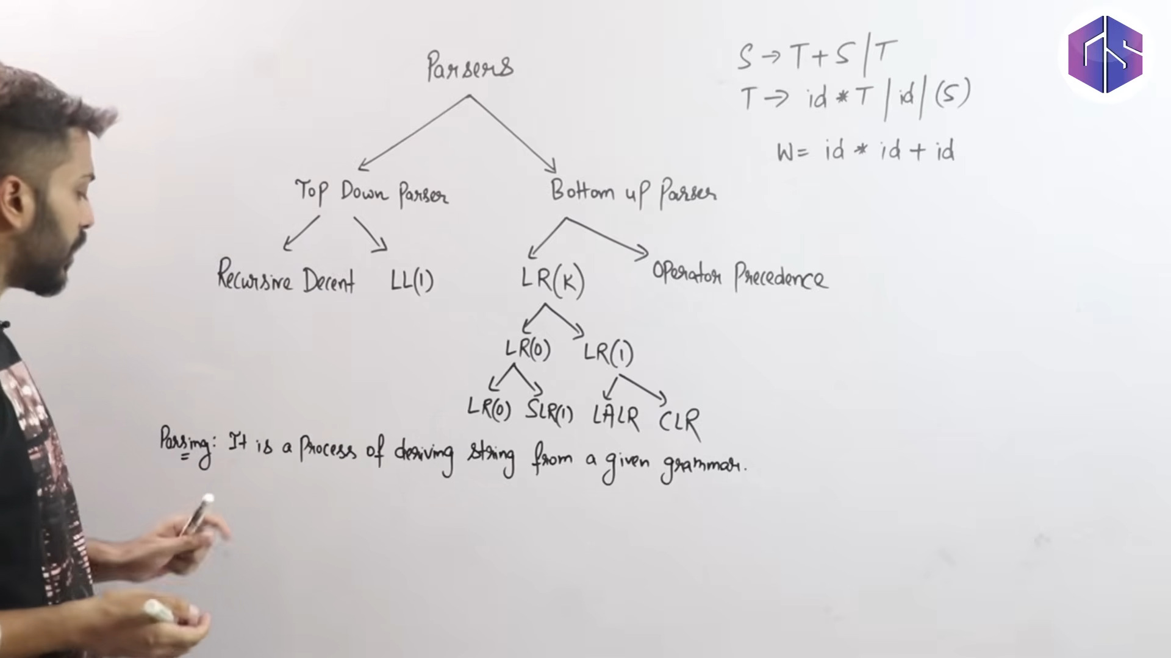

Slide 5
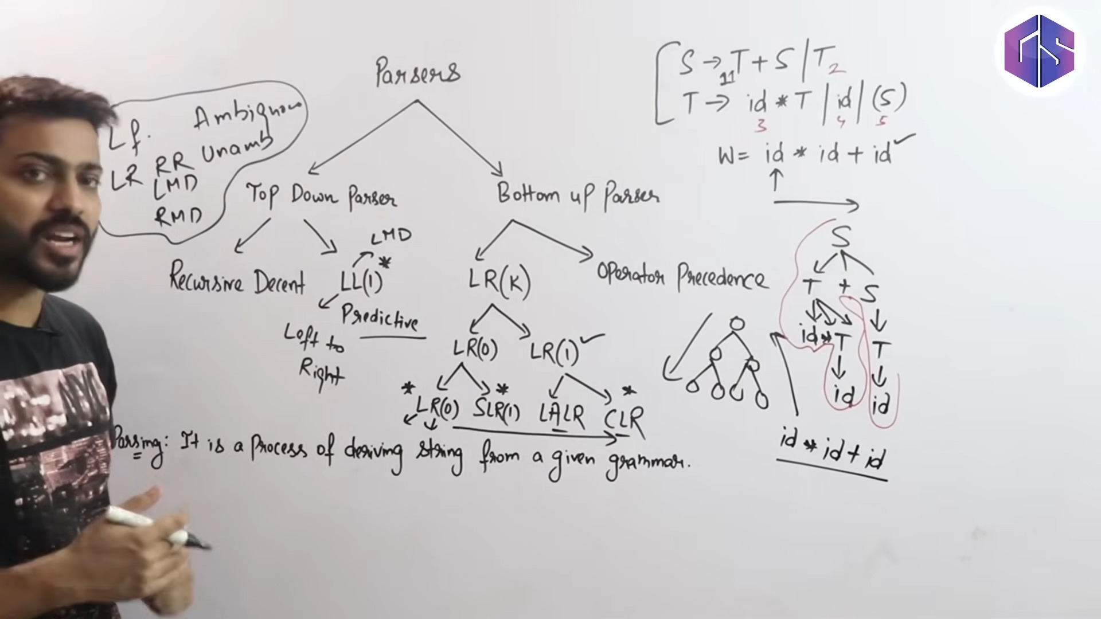

Slide 6
Parsing
Parsing
Definition (Parser)
A parser is a program that matches a sequence of tokens to the grammar rules of a context-free grammar, thereby building the syntax tree representing those tokens.
Recursive Descent Parsers

Slide 7
Parsing Algorithms
Parsing
(id + id) * id
E=> E*E=> ….=> (id + id) * id
Definition
A top-down parser begins with the start symbol and applies productions to be matched, until all the tokens have been processed.
Definition
A bottom-up parser begins by matching productions to tokens as they are read and continues until the sequence of all tokens has been reduced to the start symbol.
id + id
Recursive Descent Parsers

Slide 8
Parsing Algorithms
Parsing
Top-down parsers traverse the parse tree from the top down. They tend to be simpler, but less powerful.
Bottom-up parsers traverse the parse tree from the bottom up. They tend to be more complex, but more powerful.
Recursive Descent Parsers

Slide 9
Parsing Algorithms
Parsing
Bison
There are two basic methods of implementing top-down parsers.
Recursive descent parsers
Table-driven parsers, also called LL parsers
Bottom-up parsers, also called LR parsers, are table-driven
Recursive Descent Parsers

Slide 10


Outline
LL Parsers and LR Parsers
1
Parsing
2
LL Parsers and LR Parsers
Recursive Descent Parser
Example
Recursive Descent Parsers

Slide 11

LL Parsers
LL Parsers and LR Parsers
(id +id) * id
Definition (LL Parser)
An LL parser parses the input from left to right (L) and uses a leftmost derivation (L).
Definition (LR Parser)
An LR parser parses the input from left to right (L) and uses a rightmost derivation (R).
Recursive Descent Parsers

Slide 12

Outline
Recursive Descent Parser
1
Parsing
2
LL Parsers and LR Parsers
3 Recursive Descent Parser
4 Example
Recursive Descent Parsers

Slide 13
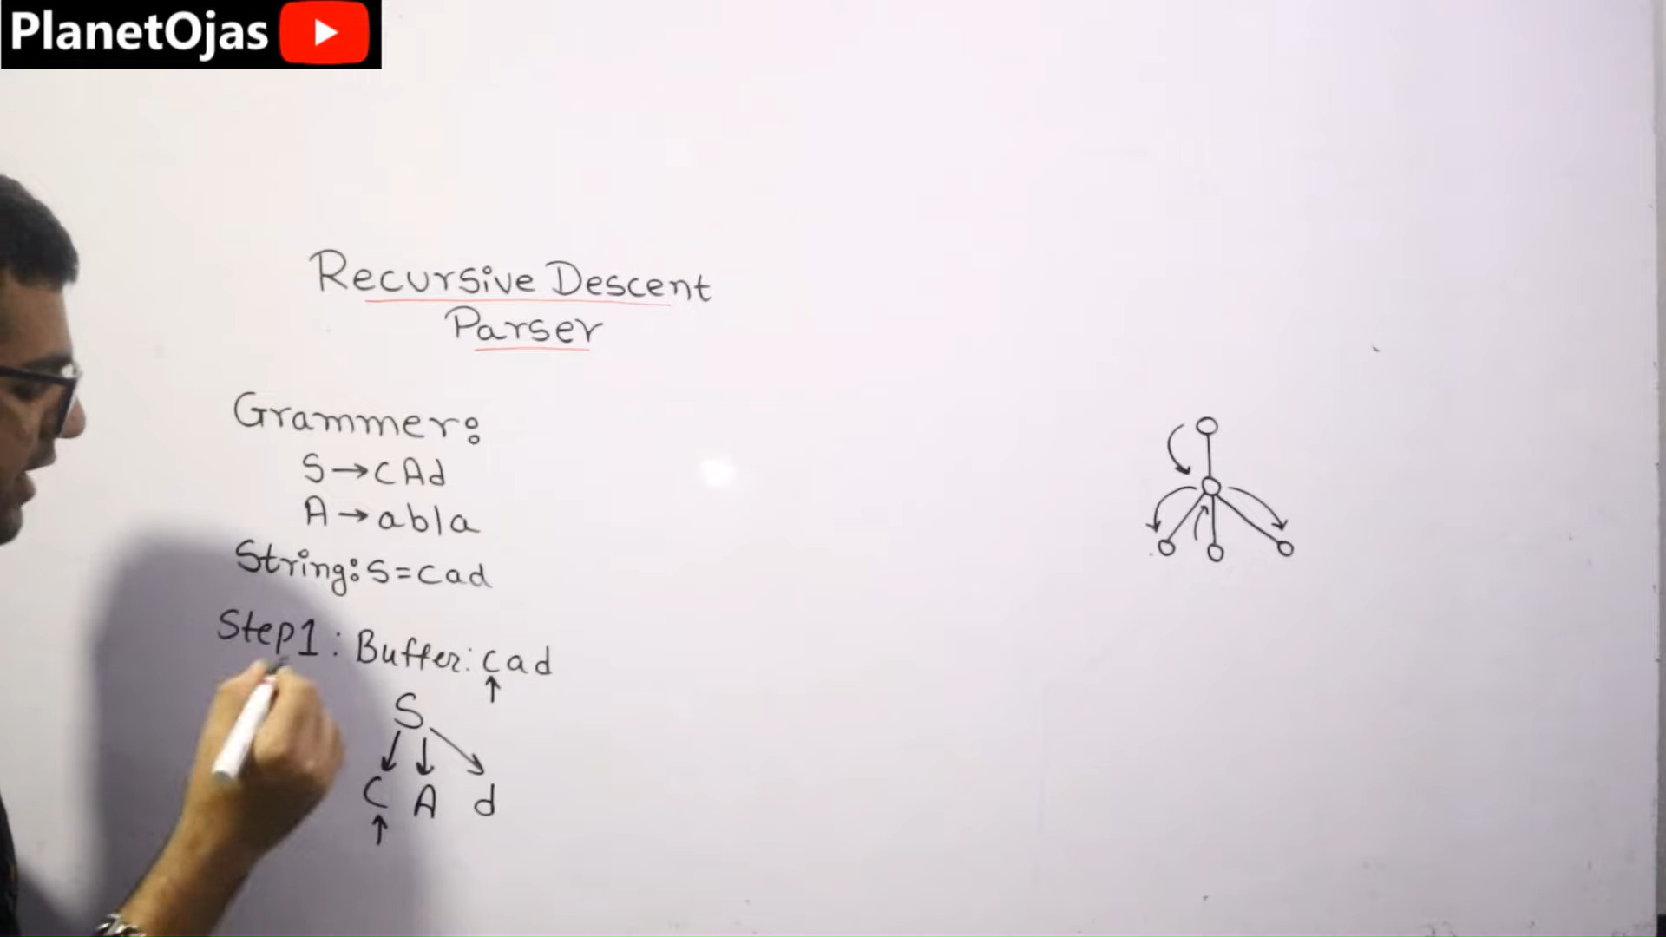

Slide 14
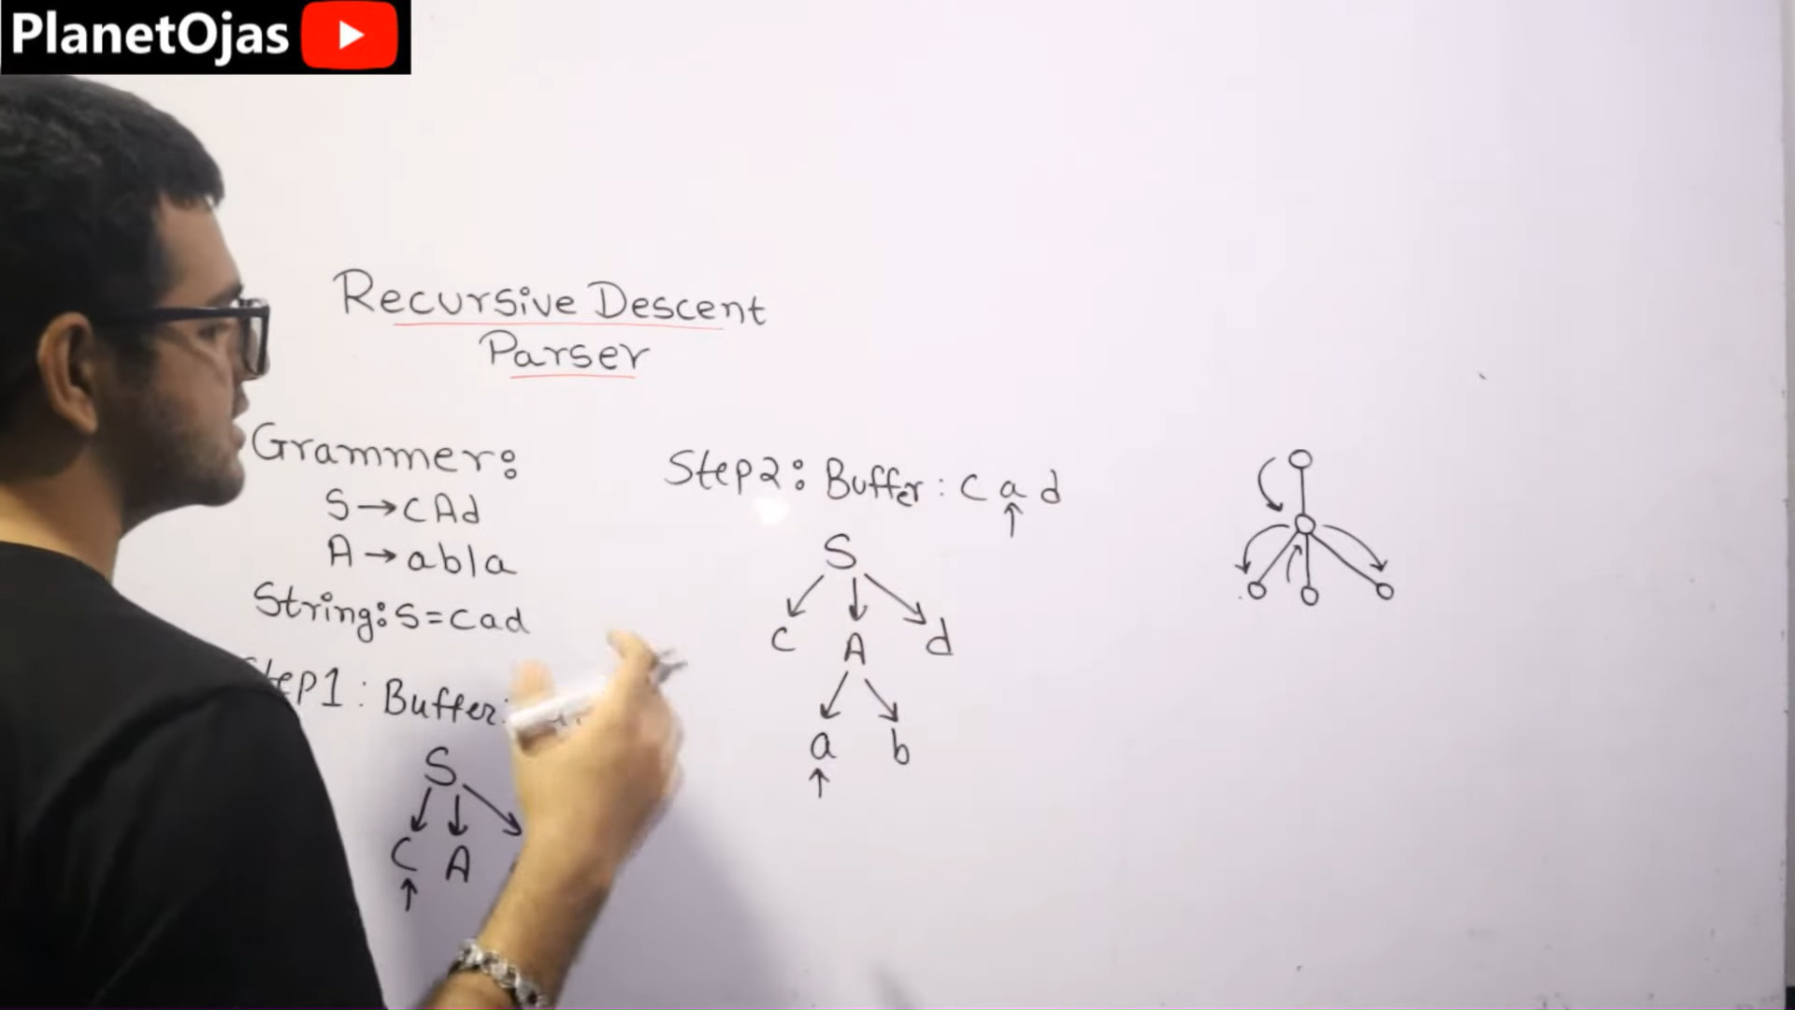

Slide 15
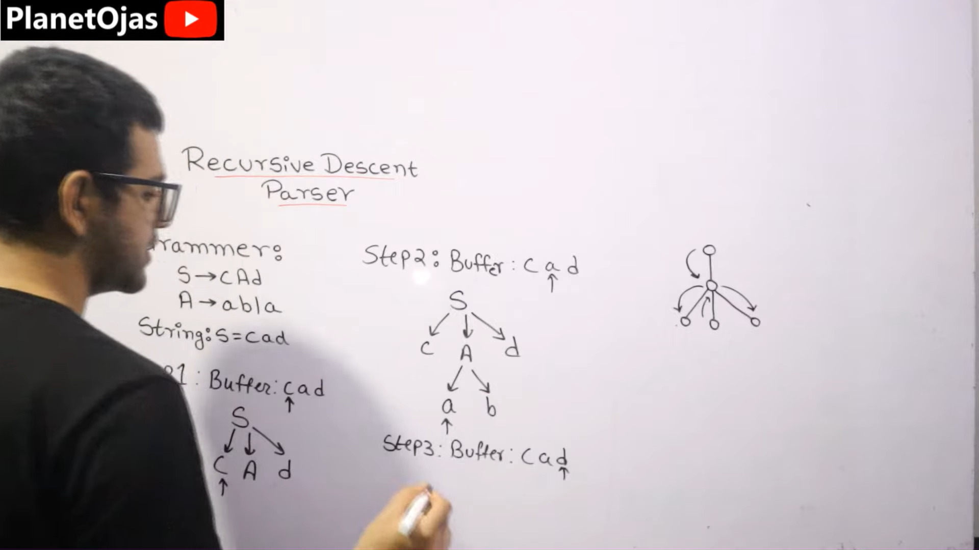

Slide 16
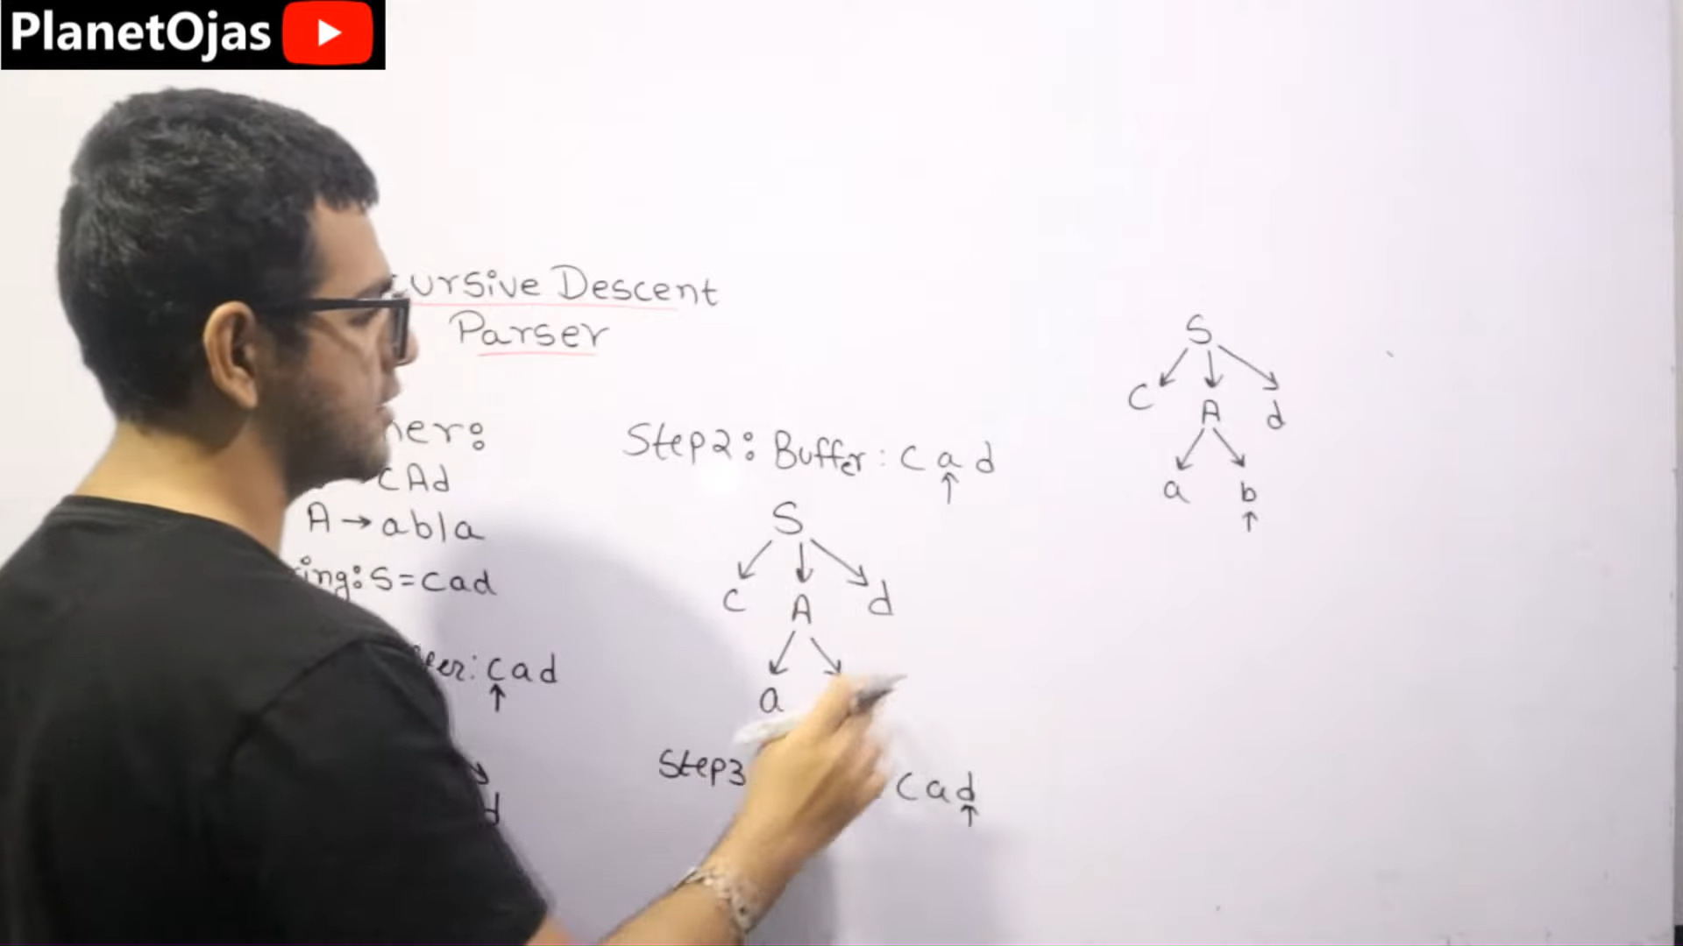

Slide 17
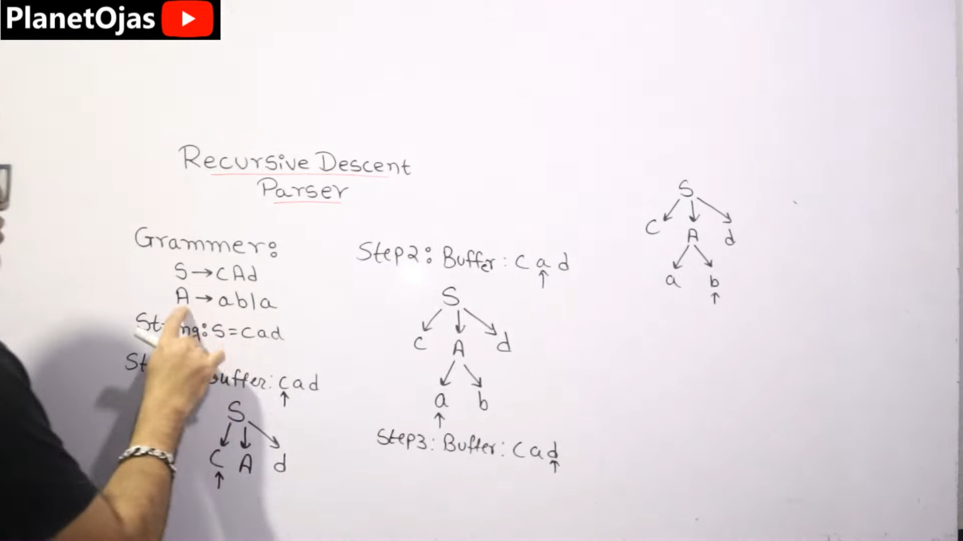

Slide 18
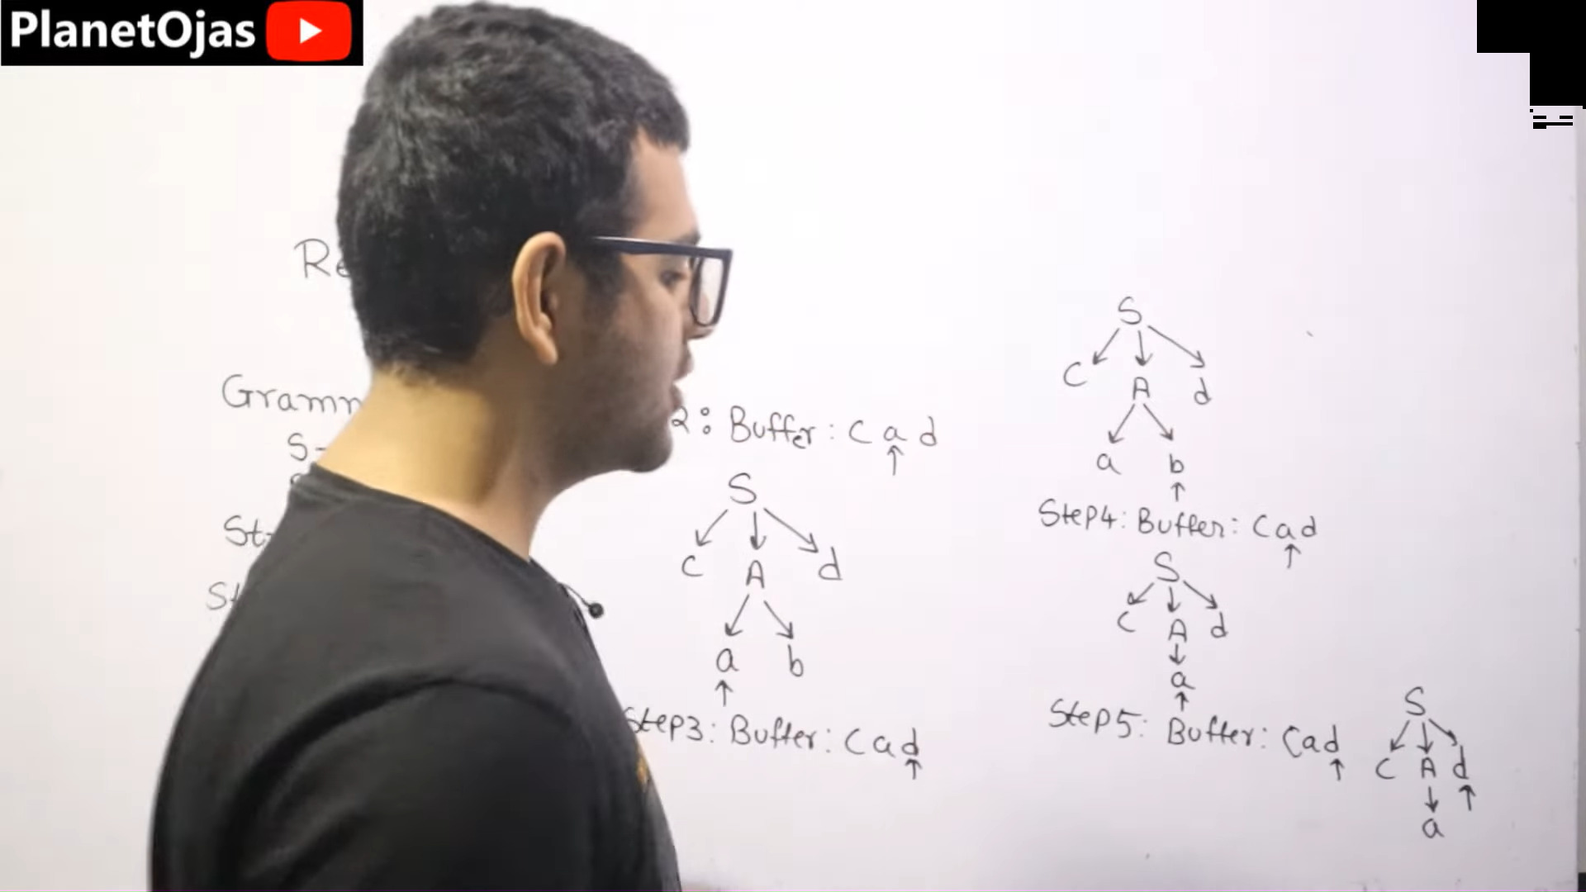

Slide 19
Recursive Descent Parser
S(){
A();
B();
C();
}
Recursive Descent Parser
id + id id - id
E () {
E();
match(‘+’); E();
}
E —> E + E
Definition (Recursive Descent Parser) In a recursive descent parser,
Each nonterminal in the grammar is implemented as a function.
Parsing begins with the start symbol S by calling the function S().
Based on the first token received, an S-productions is selected and executed. For example, if S → A B C is selected, then the functions A(), B(), and C() are called, in that order.
Continue in this manner until S is “satisfied.” That is, all tokens have been matched with the bodies of the productions.
Recursive Descent Parsers

Slide 20
Recursive Descent Parsers
Recursive Descent Parser
The first Pascal compiler used a recursive descent parser.
Recursive descent parsers have the benefit of being very simple to implement.
However,
Error-recovery is difficult.
They are not able to handle as large a set of grammars as other parsing methods.
Recursive Descent Parsers

Slide 21
Error Recovery
Recursive Descent Parser
When a syntax error occurs, in order for the compiler to recover, it usually has to discard the last few tokens, move to the end of the line, and resume.
In a recursive descent parser, discarding tokens involves returning from several nested function calls.
In a table-driven parser, discarding tokens requires simply clearing part of the stack.
Recursive Descent Parsers

Slide 22

Example
Outline
1
Parsing
2
LL Parsers and LR Parsers
3 Recursive Descent Parser
4 Example
Recursive Descent Parsers

Slide 23
Example
Example
Example (Recursive Descent)
S(){
case 1:
‘if’ C() ‘then’ S(); case 2:
Write a parser for the following grammar.
‘while’ C() ‘do’ S(); case 3:
‘id’ ‘=‘ ‘num’ ‘;’ case 4:
‘id’ ‘+’ ‘+’ ‘;’
default: syntax error;
}
C(){
S → if C then S
| while C do S
| id = num ;
| id ++ ;
case 1: ‘id’ ‘==‘ num’
C → id == num | id != num
where S represents a statement and C represents a condition.
Recursive Descent Parsers

Slide 24
Example
Example
Example (Recursive Descent)
Modify the previous example by adding the productions
S → do S while C ;
C → id < num
Recursive Descent Parsers

Slide 25
Example
Example
Example (Recursive Descent)
Modify the previous example by adding the production
S′ → S S′ | ε
where S′ represents a sequence of statements.
Recursive Descent Parsers

